Slide 1
Brief Overview of Agile
Michael Medvedev

Slide 2
Various Roles Of Scrum
Product Owner
Maximizes Value of the product and the team. Functions include refining backlog, creating user stories
Scrum Master
Responsible for for ensuring scrum is enacted and understood by scrum team and stakeholders. Functions include facilitating scrum events and removing impediments to the development teams process
Developer
Executes the iterative development procedure using user story requirements. Functions include completing sprint tasks, decides time box of incremental development.
Tester
More than just a QA tester, creates tests cases based of user story requirements. Test cases are viewed as success criteria, aggressive testing is used in test-driven development

Slide 3
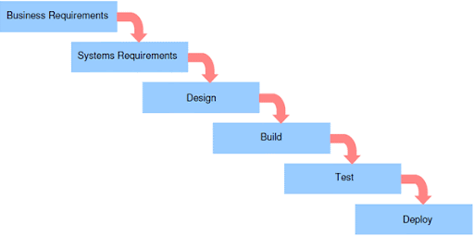
SDLC Phases
The different phases of the scrum-agile framework decreases the level of uncertainty with each phase.
Project-Level Planning
Defines the scope
High level overview with less upfront planning
Includes Project vision with high level cost
Release-Level Planning
Current release of product is defined sufficiently
Major problems resolved, allocating user stories
Contains defined Release backlog, Design Approach
Iteration-Level Planning
Development begins here
Estimation for tasks
Iterations Backlog

Slide 4

Traditional Planning
More upfront cost/planning
Stricter documentation
Heavier Failures
Not Adaptive
Development in phases is more error prone
Less collaboration more documentation

Slide 5
WaterFall or Agile?
Rather than choosing one or the other use a hybrid
Sometimes some qualities are needed from or the other
Tasks like building a bridge need strict documentation and upfront planning
You can’t decide to build the middle of the bridge first
Good project managers apply principles from both when needed.

Slide 6
Works Cited
Cobb, C. G. (2015). The Project Manager's Guide to Mastering Agile: Principles and practices for an adaptive approach. John Wiley.

